Slide 1

Here is where your presentation begins

Slide 2
Contents of this template
You can delete this slide when you’re done editing the presentation
Fonts | To view this template correctly in PowerPoint, download and install the fonts we used
Used and alternative resources | An assortment of graphic resources that are suitable for use in this presentation
Thanks slide | You must keep it so that proper credits for our design are given
Colors | All the colors used in this presentation
Icons and infographic resources | These can be used in the template, and their size and color can be edited
Editable presentation theme | You can edit the master slides easily. For more info, click here
For more info: SLIDESGO | BLOG | FAQs
You can visit our sister projects: FREEPIK | FLATICON | STORYSET | WEPIK | VIDEVO

Slide 3
Table of contents
01
05
02
06
03
07
04
08
Introduction lead funnel
Lead nurturing and engagement
About target audience analysis
Sales funnel and conversion
Lead generation strategies
CRM integration and lead management
Lead capture and landing pages
Measurement and analytics

Slide 4
Sales funnel
This can be the part of the presentation where you introduce yourself, write your email or contact data…

Slide 5
01
Introduction
You can enter a subtitle here if you need it

Slide 6
Overview
You can give a brief description of the topic you want to talk about here. For example, if you want to talk about Mercury, you can say that it’s the smallest planet in the entire Solar System

Slide 7
About the lead funnel
Mercury is the closest planet to the Sun and the smallest one in the entire Solar System. This planet's name has nothing to do with the liquid metal, since Mercury was named after the Roman messenger god. Despite being closer to the Sun than Venus, its temperatures aren't as terribly hot as that planet's. Its surface is quite similar to that of Earth's Moon, which means there are a lot of craters and plains
Speaking of craters, many of them were named after artists or authors who made significant contributions to their respective fields. Mercury takes a little more than 58 days to complete its rotation, so try to imagine how long days must be there! Since the temperatures are so extreme and the solar radiation is so high, Mercury has sadly been considered to be non-habitable for humans

Slide 8

Objectives of the presentation
Do you know what helps you make your point clear?
Lists like this one:
They’re simple
You can organize your ideas clearly
You’ll never forget to buy milk!
And the most important thing: the audience won’t miss the point of your presentation

Slide 9
Target audience analysis
Customer needs
Mercury is the closest planet to the Sun and the smallest one in the Solar System—it’s only a bit larger than the Moon. This planet’s name has nothing to do with the liquid metal, since Mercury was named after the Roman messenger god
Pain points
Venus has a beautiful name and is the second planet from the Sun. It’s terribly hot—even hotter than Mercury—and its atmosphere is extremely poisonous. It’s the second-brightest natural object in the night sky after the Moon

Slide 10
How to define your target audience
01. Demographics
02. Psychographics
03. Behavior
04. Pain points
Age
Gender
Location
Occupation
Income level
Interests, hobbies
Values and beliefs
Lifestyle choices
Personality traits
Attitudes, opinions
Buying habits
Online activities
Social media
Consumption
Brand preferences
Identify most common problems and challenges your target audience faces
05. Aspirations
06. Communication
07. Customer
08. Customer journey
Understand the goals, objectives, ambitions and aspirations of your target audience
Highlight preferred channels of communication (e.g., email, social media, in-person)
Based on the analysis of demographic, psychographic, behavioral data
Highlight opportunities for lead generation and engagement at each stage

Slide 11
Lead generation strategies
Content marketing
Social media marketing
Email marketing
Jupiter is a gas giant and the biggest planet in the Solar System. It's the fourth-brightest object in the night sky and was named after the Roman god of the skies
Venus has a beautiful name and is the second planet from the Sun. It’s terribly hot and its atmosphere is poisonous. It’s the second-brightest natural object in the night sky
Saturn is a gas giant and has several rings. This planet is composed mostly of hydrogen and helium. Saturn was named after a Roman god, and is the sixth planet from the Sun

Slide 12
Lead generation strategies diagram
Lead generation strategies in a marketing-focused lead funnel
Content marketing
Paid advertising
Lead magnets
Referral programs
Event marketing
Opt-in offers
Social media
SEO
Partnerships
Email marketing
Direct outreach
Collaborations

Slide 13
Lead capture and landing pages
Landing page design
Lead capture forms
Despite being red, Mars is actually a cold place. It's full of iron oxide dust, which gives the planet its reddish cast, and it’s made of basalt
Venus has a beautiful name and is the second planet from the Sun. It’s terribly hot and its atmosphere is extremely poisonous
Lead magnets
Conversion rate optimization
Jupiter is a gas giant and the biggest planet in the Solar System. It's the fourth-brightest object in the night sky and was named after a Roman god
Saturn is a gas giant and has several rings. It's composed mostly of hydrogen and helium. It’s the sixth planet from the Sun

Slide 14
Lead nurturing and engagement
Lead nurturing campaigns
Email marketing automation
Personalization and segmentation
Despite being red, Mars is actually a cold place. It’s full of iron oxide dust, which gives the planet its reddish cast
Venus has a beautiful name and is the second planet from the Sun. It’s terribly hot, even hotter than Mercury
Neptune is the farthest planet from the Sun. It’s also the fourth-largest planet by diameter in the Solar System
Multi-channel engagement
About lead scoring
CRM integration
Earth is the third planet from the Sun and the only one in the Solar System that harbors life. We all live on this planet
Saturn is a gas giant and has rings. It’s composed mostly of hydrogen and helium. It’s the sixth planet from the Sun
Jupiter is a gas giant and the biggest planet in the Solar System. It’s the fourth-brightest object in the night sky

Slide 15
Marketing funnel

Slide 16
“This is a quote, words full of wisdom that someone important said and can make the reader get inspired”
—Someone Famous

Slide 17

A picture is worth a thousand words

Slide 18

A picture always reinforces the concept
Images reveal large amounts of data, so remember: use an image instead of a long text. Your audience will appreciate it

Slide 19
Sales funnel and conversion
01
Awareness stage
02
Interest stage
03
Consideration stage
04
Decision stage
05
Conversion stage

Slide 20
98,300,000
Big numbers catch your audience’s attention

Slide 21
1,000 leads
100 qualified leads
A generic number could be 1,000 leads, representing the initial pool of potential customers or prospects
A generic number could be 100 qualified leads, representing a subset of the total leads who have met the qualifying criteria and are more likely to convert into customers

Slide 22
Generic percentages
2-5%
60-80%
0%
100%
0%
100%
Conversion rate
Funnel leakage
A generic conversion rate percentage could be around 2-5%, indicating that out of every 100 leads, 2-5 of them convert into customers or take the desired action
A generic funnel leakage percentage could be around 60-80%, indicating that a significant percentage of leads may drop off or become inactive at different stages of the funnel

Slide 23
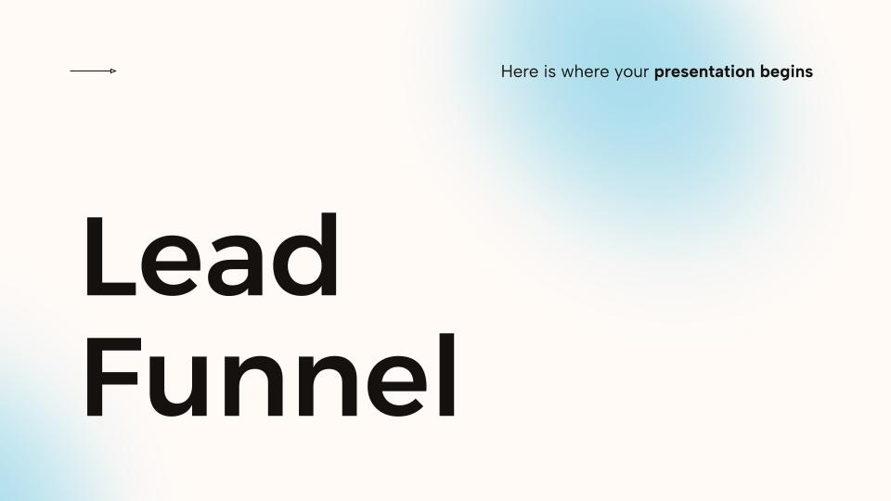
Computer mockup
You can replace the image on the screen with your own work. Just right-click on it and select “Replace image”

Slide 24
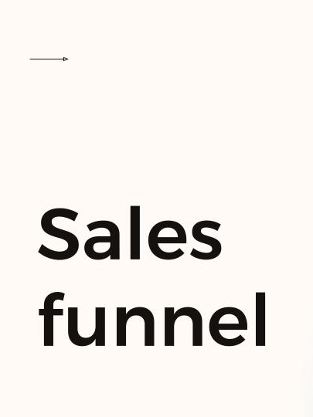
Tablet mockup
You can replace the image on the screen with your own work. Just right-click on it and select “Replace image”

Slide 25
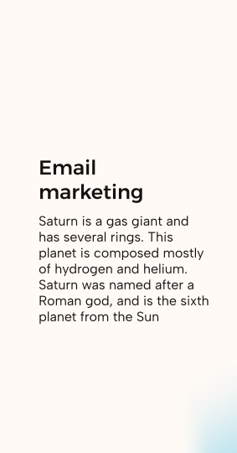
Phone mockup
You can replace the image on the screen with your own work. Just right-click on it and select “Replace image”

Slide 26
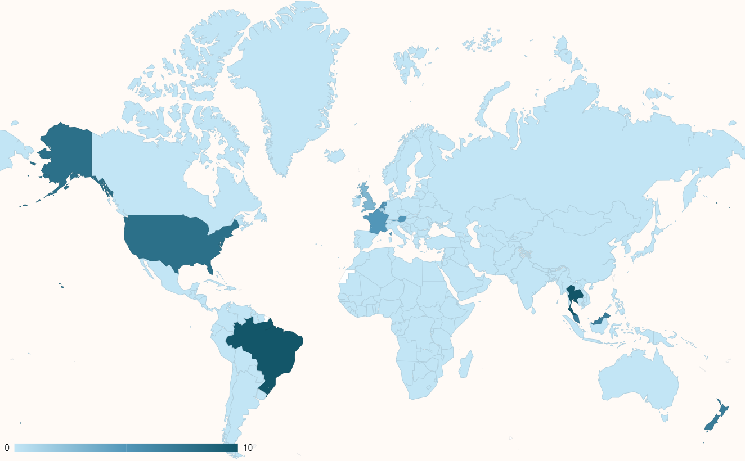
This is a map
Mercury
Venus
Saturn
Follow the link in the map to modify its data and then paste the new one here. For more info, click here

Slide 27
CRM integration and lead management
CRM integration
Lead tracking and management
Contact and account management
Automated workflows and campaigns
Reporting and analytics
Collaboration and communication
Data integrity and GDPR compliance

Slide 28
Important concepts about CRM integration
Concepts about CRM integration and lead management
Streamlined lead tracking and management
Enhanced lead nurturing and personalization
CRM integration enables businesses to efficiently track and manage leads throughout the entire customer journey
With CRM integration, businesses can automate lead assignment, track lead interactions, and monitor lead progression through the sales funnel
CRM integration empowers businesses to deliver personalized and targeted communication to leads
By leveraging CRM data, businesses can segment leads based on demographics, behaviors, and interests, allowing for tailored marketing campaigns

Slide 29
This is a table
 | Team A | Team B | Team C | Team D | Team E | Team F
Mercury | XX | XX | XX | XX | XX | XX
Mars | XX | XX | XX | XX | XX | XX
Saturn | XX | XX | XX | XX | XX | XX
Venus | XX | XX | XX | XX | XX | XX
Jupiter | XX | XX | XX | XX | XX | XX
Earth | XX | XX | XX | XX | XX | XX
Moon | XX | XX | XX | XX | XX | XX

Slide 30
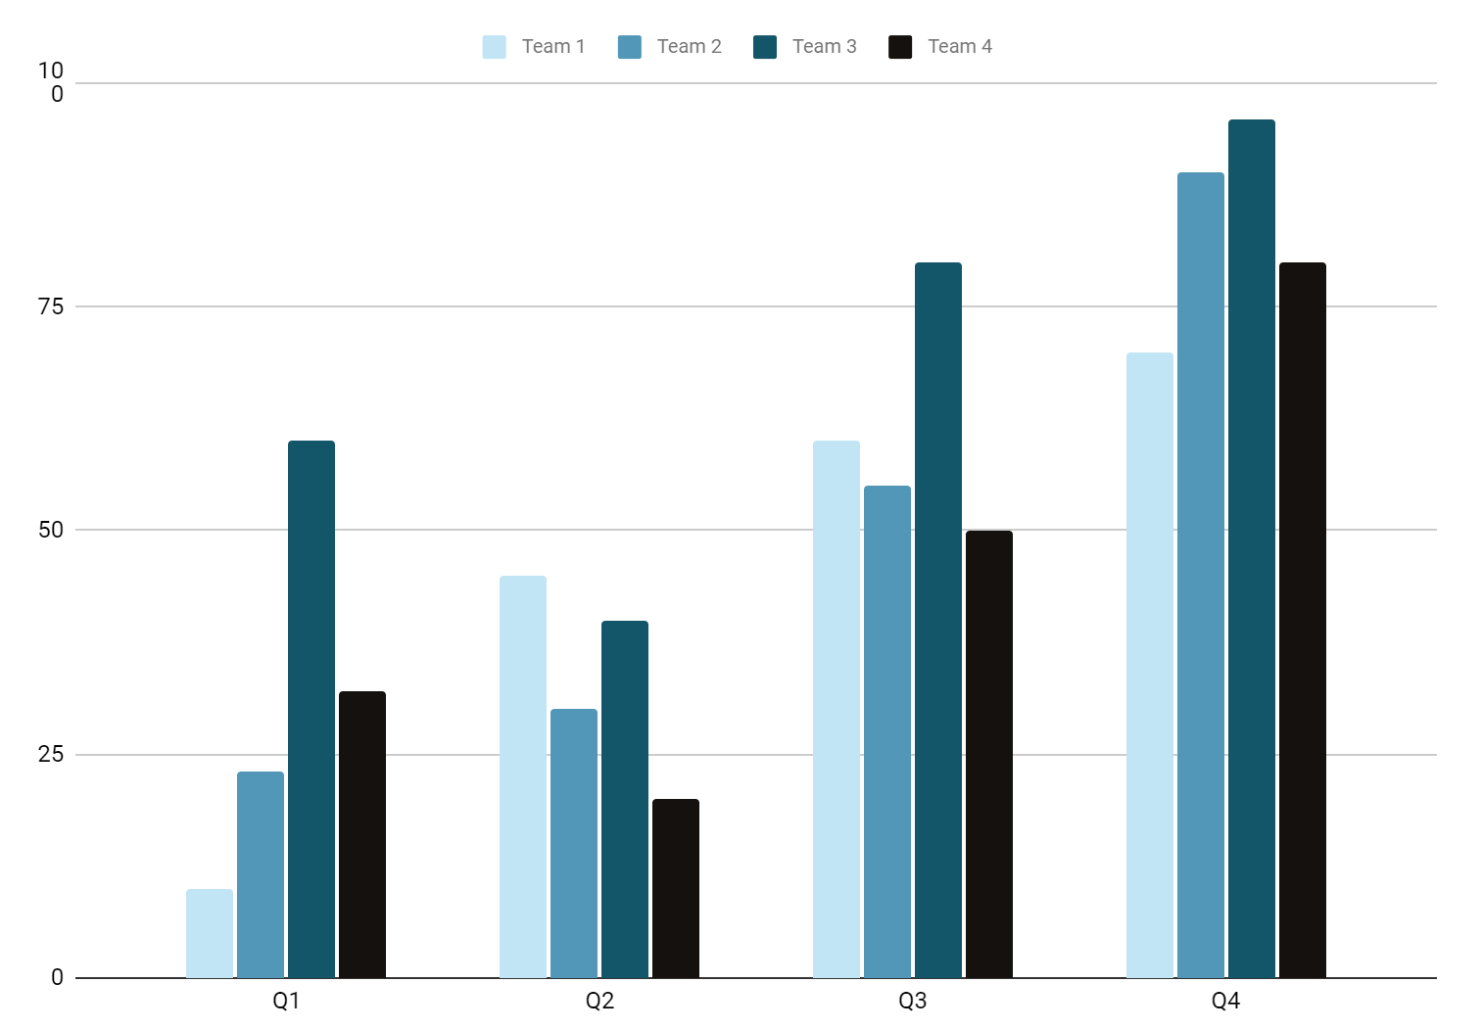
This is graph
Team 1
Team 2
Team 3
Team 4
Follow the link in the graph to modify its data and then paste the new one here. For more info, click here

Slide 31
Metrics and analytics
01
02
03
Key performance indicators (KPIs)
Funnel
analytics
Traffic sources
and attribution
04
05
06
Customer lifetime value (CLV)
A/B testing and experimentation
Data visualization

Slide 32
Items about metrics and analytics
Metrics and analytics
KPIs
Funnel analytics
Conversion rate
Drop-off points
Cost per lead
Traffic sources
ROI
Attribution

Slide 33
Final conclusions
01 | 02 | 03 | 04 | 05
Lead generation fuels business growth and sales success | Nurturing leads is essential for building strong customer relationships | Understanding your target audience is the key to effective marketing | CRM integration streamlines lead management and boosts efficiency | Personalized communication enhances engagement and conversions
06 | 07 | 08 | 09 | 10
Continuous testing and optimization drive better marketing results | Quality content attracts and engages prospects throughout the funnel | Effective lead scoring helps prioritize and focus on high-value leads | Collaboration between sales and marketing teams maximizes conversions | Measuring key metrics provides insights for ongoing improvements

Slide 34



Our team
Jenna Doe
Timmy Jimmy
Susan Smith
You can speak a bit about this person here
You can speak a bit about this person here
You can speak a bit about this person here

Slide 35
Thanks!
Do you have any questions?
youremail@freepik.com
+91 620 421 838
yourwebsite.com
Please keep this slide for attribution

Slide 36



Alternative resources
Here’s an assortment of alternative resources whose style fits that of this template:
Free PSD dynamic graphics design instagram posts

Slide 37
Resources
Did you like the resources in this template? Get them for free at our other websites:
Photos
Medium shot woman with earphones
Working from home in ergonomic workstation
Home workspace minimalistic design
Front view female economist holding laptop
African american man remote working from home
Front view of elegant businesswoman with agenda
Vectors
Free PSD dynamic graphics design instagram posts

Slide 38
Instructions for use
If you have a free account, in order to use this template, you must credit Slidesgo by keeping the Thanks slide. Please refer to the next slide to read the instructions for premium users.
As a Free user, you are allowed to:
Modify this template.
Use it for both personal and commercial projects.
You are not allowed to:
Sublicense, sell or rent any of Slidesgo Content (or a modified version of Slidesgo Content).
Distribute Slidesgo Content unless it has been expressly authorized by Slidesgo.
Include Slidesgo Content in an online or offline database or file.
Offer Slidesgo templates (or modified versions of Slidesgo templates) for download.
Acquire the copyright of Slidesgo Content.
For more information about editing slides, please read our FAQs or visit our blog:
https://slidesgo.com/faqs and https://slidesgo.com/slidesgo-school

Slide 39
Instructions for use (premium users)
As a Premium user, you can use this template without attributing Slidesgo or keeping the Thanks slide.
You are allowed to:
Modify this template.
Use it for both personal and commercial purposes.
Hide or delete the “Thanks” slide and the mention to Slidesgo in the credits.
Share this template in an editable format with people who are not part of your team.
You are not allowed to:
Sublicense, sell or rent this Slidesgo Template (or a modified version of this Slidesgo Template).
Distribute this Slidesgo Template (or a modified version of this Slidesgo Template) or include it in a database or in any other product or service that offers downloadable images, icons or presentations that may be subject to distribution or resale.
Use any of the elements that are part of this Slidesgo Template in an isolated and separated way from this Template.
Register any of the elements that are part of this template as a trademark or logo, or register it as a work in an intellectual property registry or similar.
For more information about editing slides, please read our FAQs or visit our blog:
https://slidesgo.com/faqs and https://slidesgo.com/slidesgo-school

Slide 40
Fonts & colors used
This presentation has been made using the following fonts:
Alexandria
(https://fonts.google.com/specimen/Alexandria)
Albert Sans
(https://fonts.google.com/specimen/Albert+Sans)
#15110e
#fffaf6
#c2e5f5
#5296b8
#135669
#ffffff

Slide 41





Storyset
Create your Story with our illustrated concepts. Choose the style you like the most, edit its colors, pick the background and layers you want to show and bring them to life with the animator panel! It will boost your presentation. Check out how it works.
Pana
Amico
Bro
Rafiki
Cuate

Slide 42
Use our editable graphic resources...
You can easily resize these resources without losing quality. To change the color, just ungroup the resource and click on the object you want to change. Then, click on the paint bucket and select the color you want. Group the resource again when you’re done. You can also look for more infographics on Slidesgo.

Slide 45
JANUARY
FEBRUARY
MARCH
APRIL
MAY
JUNE
PHASE 1
Task 1
Task 2
PHASE 2
Task 1
Task 2
JANUARY
FEBRUARY
MARCH
APRIL
PHASE 1
Task 1
Task 2

Slide 48
...and our sets of editable icons
You can resize these icons without losing quality.
You can change the stroke and fill color; just select the icon and click on the paint bucket/pen.
In Google Slides, you can also use Flaticon’s extension, allowing you to customize and add even more icons.

Slide 49
Educational Icons
Medical Icons

Slide 50
Business Icons
Teamwork Icons

Slide 51
Help & Support Icons
Avatar Icons

Slide 52
Creative Process Icons
Performing Arts Icons

Slide 53
Nature Icons

Slide 54
SEO & Marketing Icons

Slide 55


